Slide 1
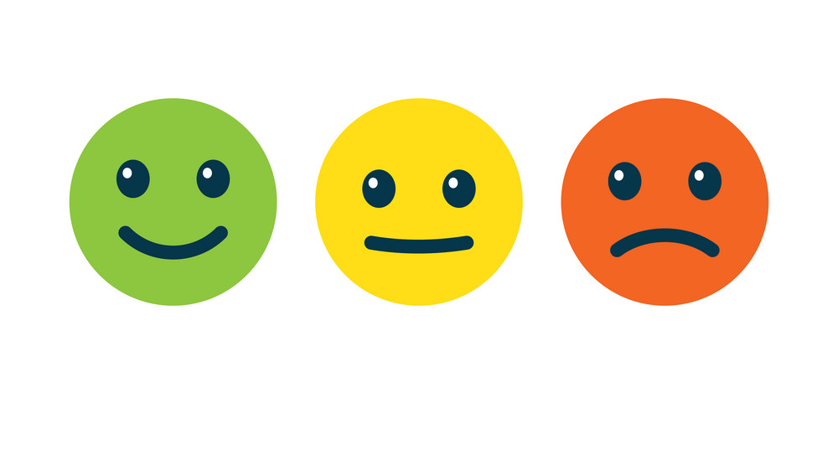

Tweet Sentiment Classification
Bethel Ikejiofor & Valerie Huston
Notes:
Bethel

Slide 2
About Me: Bethel Ikejiofor
BS in Applied Math from Rensselaer Polytechnic Institute
Worked as a Data Analyst at Bloomberg LP & JPMorgan Chase
Incoming Associate Data Engineer
Notes:
Bethel

Slide 3
About Me: Valerie Huston
BA in Theater Arts
AS in Culinary Arts
Experienced in Accounting, Television, Family Law, Catering, and Stadium Sports
Notes:
Valerie

Slide 4
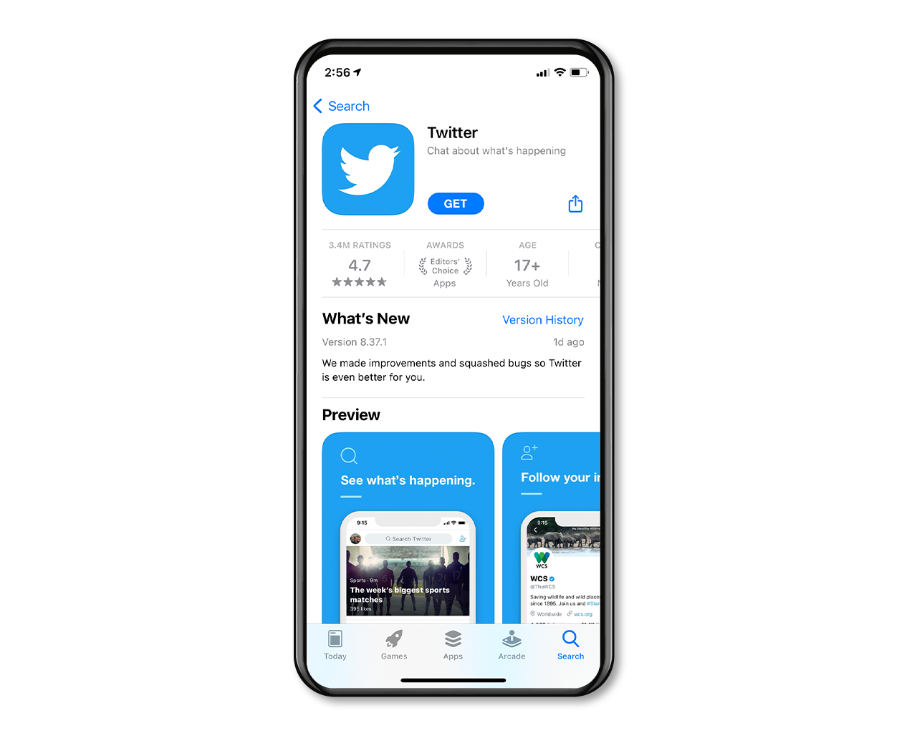
What is Twitter?
A social media forum that connects users all over the world
Users can tweet anything that crosses in their mind that can fit in 280 characters, whether it be positive, negative, or neutral.
Anyone over 13 can have an account, including companies, who mainly use it for PR
Notes:
Valerie

Slide 5
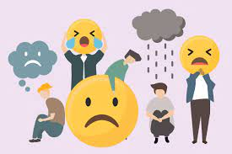
Background
The objective of this project is to classify the overall sentiment of a tweet's context as neutral, negative, or positive using NLP classifiers. To complete, this project, we are given a dataset of 27,481 tweets, where 22,464 of those tweets were captured as having either a neutral, negative, or positive sentiment. Our goal is to use this training data of ~27.5k tweets to predict the sentiment of the 3,534 tweets in our testing data set.
Notes:
Valerie

Slide 6
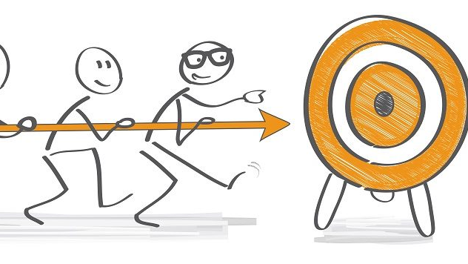
Objective
Given a testing and training set, we ran NLP on a series of tweets to categorize their sentiments as bad, good, or neutral. We then use the testing dataset to see how efficient the NLP classifier is and from there compared different sentiment analysis models.
Notes:
Bethel

Slide 7
Questions
What words contribute to how a tweet's sentiment is classified?
Given a testing set, where is a tweet likely to fall on a sentiment scale?
How does classification precision change with different classification models implemented?
Notes:
Bethel

Slide 8
Visualizing the Data
Notes:
Valerie

Slide 9
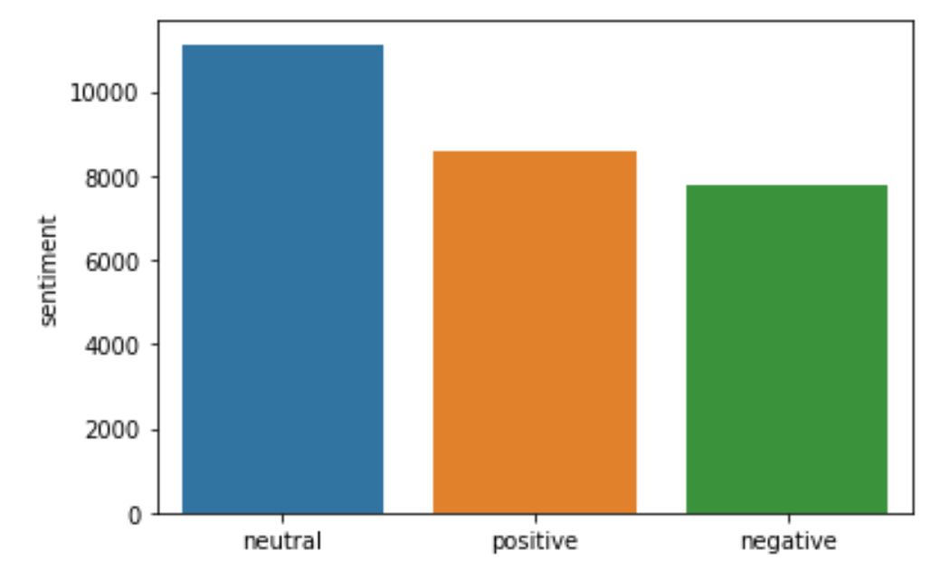
Sentiment Buckets
Most tweets in the training dataset are neutral but the data is not generally imbalanced between all sentiments.
11,118 Neutral
8,582 Positive
7,781 Negative
Notes:
Val

Slide 10
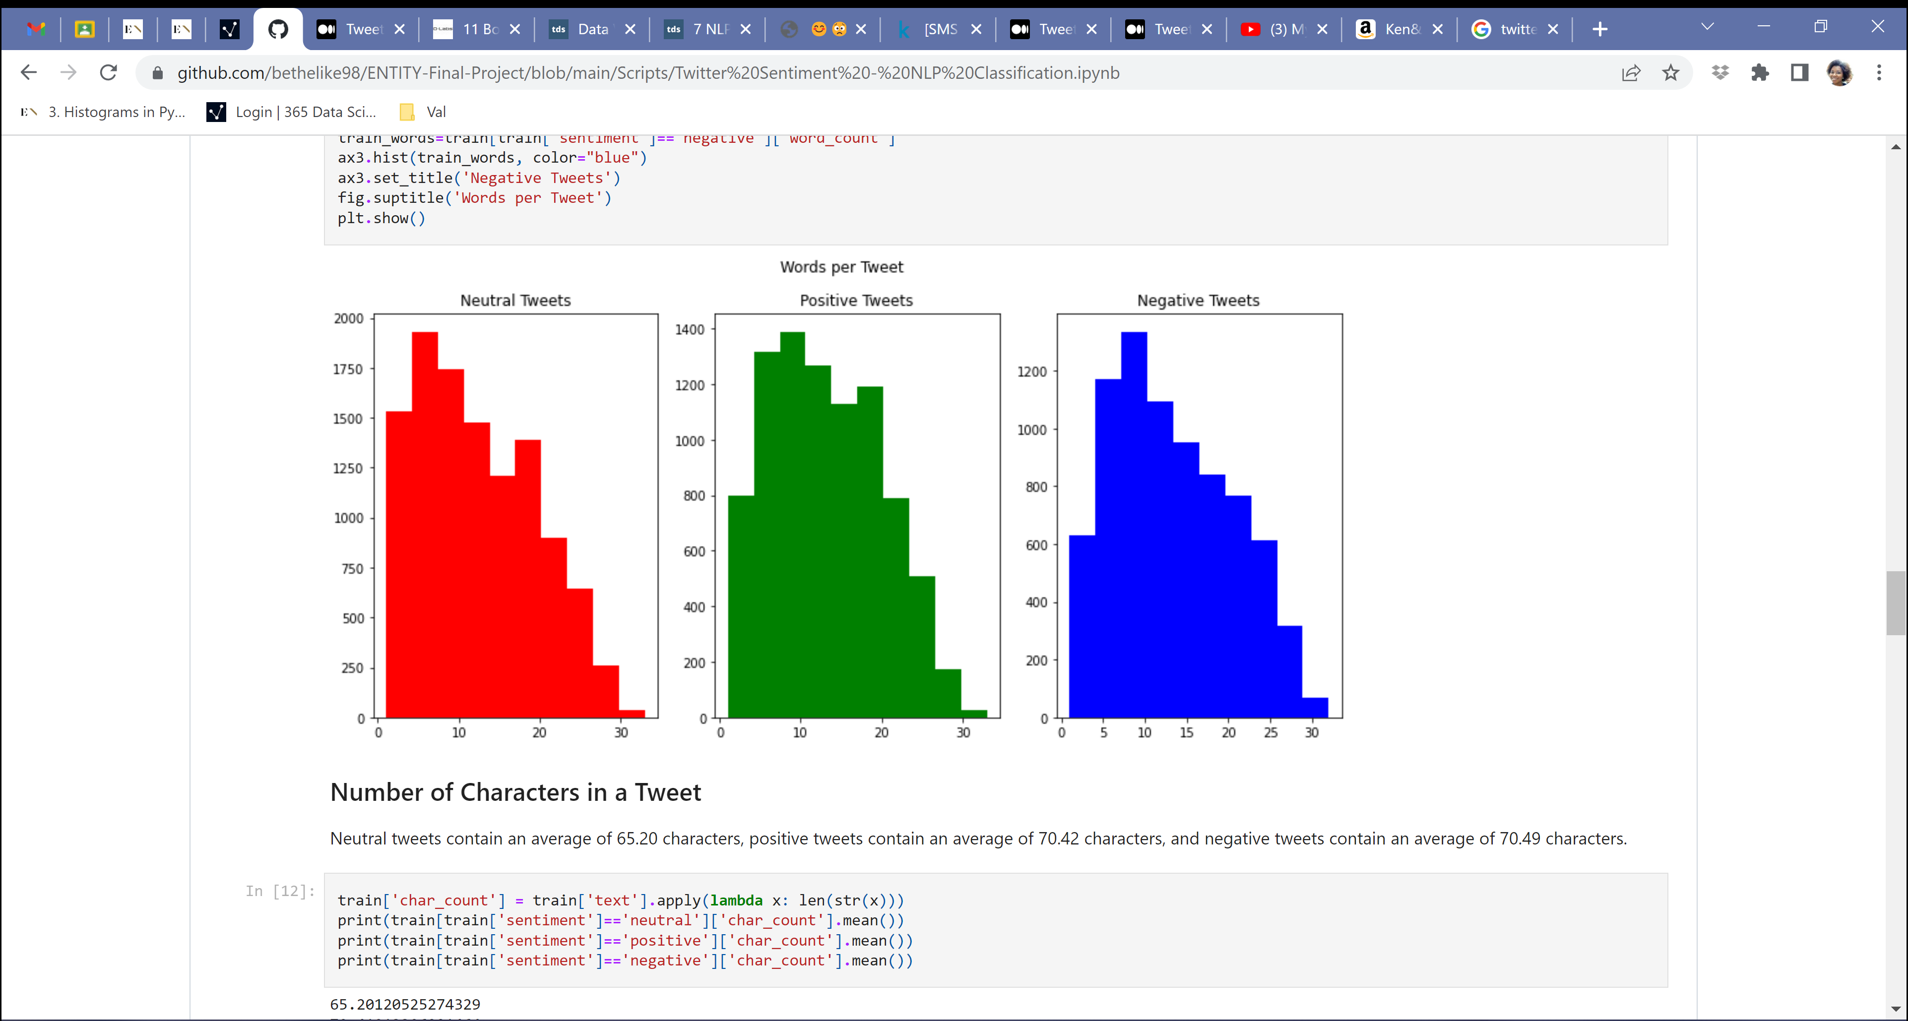
Words Per Tweet
Notes:
Val

Slide 11
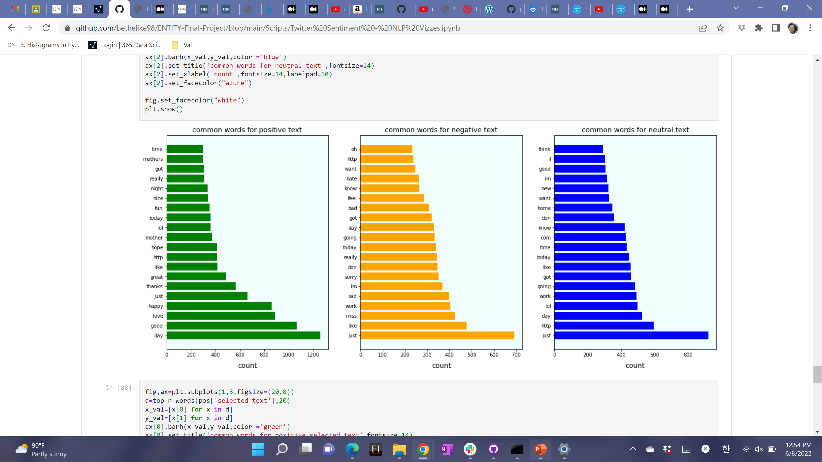
Common Words Per Sentiment
Notes:
Val

Slide 12
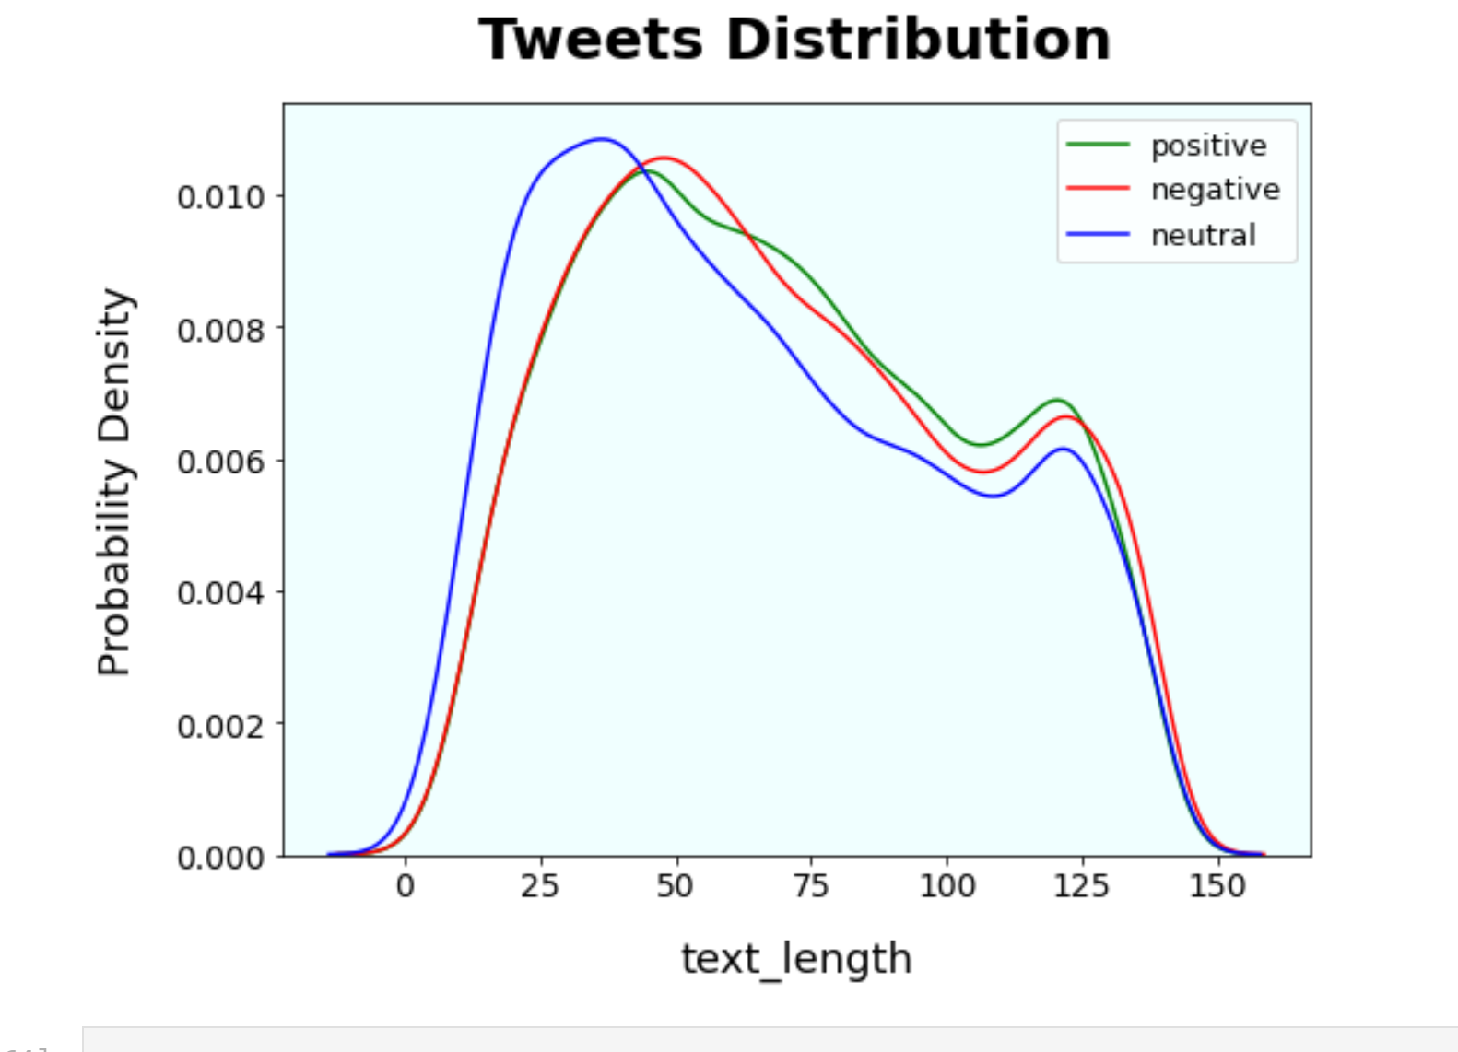
PDF of Tweet Distribution
Notes:
Val

Slide 13
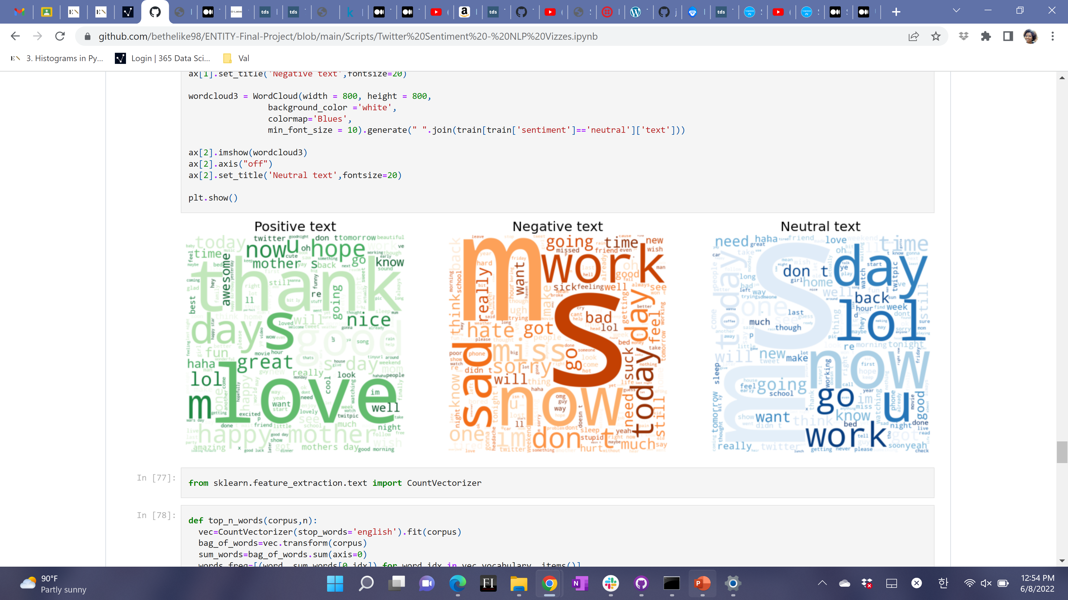
Word Clouds
Notes:
Val

Slide 14
Classification Models
Notes:
Val/Bethel

Slide 15
“p-hacking” Model
What’s p-hacking?
Manipulating data analysis to produce a favorable result as being statistically significant
Why is this the p-hacking model?
Within the analysis, depending on how we decided to order the sentiments in the end classification, results would be skewed towards whatever sentiment came first.
E.g.: If we coded our classifications as “negative, positive, neutral” instead of “positive, negative, neutral” - the first model would produce higher accuracy for negative classification while the second model would produce higher accuracy for positive classification.
Notes:
Bethel

Slide 16
“p-hacking” Model Production
Categorize positive, negative, or neutral sentiments as distinct sets dependent upon training set’s “selected_text” column and associated sentiment.
Using words in testing dataset, assign probability of text’s sentiment using sets described above, assign text to highest probability sentiment, and assess precision.
Notes:
Bethel

Slide 17
“p-Hacking” Results
Neutral | Negative | Positive
96.43% | 3.39% | 3.08%
Neutral | Positive | Negative
96.43% | 3.69% | 2.99%
Negative | Neutral | Positive
49.25% | 57.76% | 2.99%
Negative | Positive | Neutral
49.25% | 21.49% | 46.99%
Notes:
Bethel

Slide 18
“p-Hacking” Results
Positive | Negative | Neutral
49.05% | 28.27% | 46.99%
Positive | Neutral | Negative
49.05% | 60.70% | 3.40%
Notes:
Bethel

Slide 19
Afinn Model
Afinn contains 3300+ words with a polarity score associated for each word being used in a sentiment analysis.
There is a built-in function for the Afinn lexicon where scores are assigned to the text:
If score > 0, then sentiment is positive
If score < 0, then sentiment is negative
Else, the sentiment is neutral.
Notes:
Bethel

Slide 20
Afinn Example
“I hate flowers”
Score = -3.0
Afinn classifies as negative sentiment
“He’s kind and smart”
Score = 3.0
Afinn classifies as positive
“We are kind to good people”
Score = 5.0
Afinn classifies as positive
Notes:
Bethel

Slide 21
Results from Afinn Model
84% accuracy with positive sentiment tweets
62% accuracy with negative sentiment tweets
54% accuracy with neutral sentiment tweets
65% overall accuracy for sentiment classification
Notes:
Bethel

Slide 22

Flair Model
Flair utilizes a pre-trained model to detect positive or negative comments and print a number in brackets behind the label which is a prediction confidence.
It contains a powerful library which allows users to use and combine different word and document embeddings. Based on the corpus, it could analyze and tell the attitudes of the speakers. Comparing with other NLP packages, flair’s sentiment classifier is based on a character-level LSTM neural network which takes sequences of letters and words into account when predicting.
Notes:
Val

Slide 23
Flair Example
“GrabNGoInfo.com is a great machine learning tutorial website .”
Score = 0.9895
Flair classifies as positive
Notes:
Val

Slide 24
Flair Model Results
99.97% accuracy for negative sentiment
0% accuracy overall
99.73% accuracy for positive sentiment
Notes:
Val

Slide 25

TextBlob Model
TextBlob is a sentiment classifier that uses a movie reviews dataset where reviews are labeled positive or negative.
Positive and negative features are extracted from each positive and negative reviews.
This becomes the foundation of the training data, which consists of labeled positive and negative features. The data is trained on a Naïve Bayes Classifier
TextBlob then assigns the polarity of a tweet between -1 and 1.
If polarity > 0, then positive
If polarity = 0, then neutral
Else, negative
Notes:
Val

Slide 26
TextBlob Example
It’s a beautiful day.
Polarity: 0.85
The move is badly directed.
Polarity: -0.69
The weather today is pleasant
Polarity: 0.73
Positive
Negative
Positive
Notes:
Val

Slide 27
TextBlob Model Results
78.06% accuracy for positive sentiment
49.05% accuracy for negative sentiment
51.12% accuracy for neutral sentiment
58.94% accuracy overall
Notes:
Val

Slide 28
VADER Model
Valence Aware Dictionary and sEntiment Reasoner
A lexicon and rule-based sentiment analysis tool specifically designed to detect sentiment expressed in social media
Uses a list of lexical features, like words which are labeled as being positive or negative
VADER tells a positivity and negativity score but also tells you how likely a tweet is to be positive, negative, or neutral.
Notes:
Bethel

Slide 29
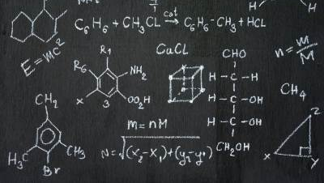
How VADER Works
Generates a compound score which is the sum of all the normalized lexicon ratings between -1(most extreme negative) and +1(most extreme positive).
If compound score >= 0.05, then positive sentiment
If compound score <= -0.05, then negative sentiment.
If compound score between -0.05 and 0.05, then neutral sentiment.
Notes:
Bethel

Slide 30

VADER Example
Sentence: “I am very sad today.”
VADER Probability:
Sentence was rated as 50.8% Negative
Sentence was rated as 49.2% Neutral
Sentence was rated as 0.0% Positive.
VADER says “Sentence Overall Rated as Negative”
Notes:
Bethel

Slide 31
VADER Model Results
88.49% accuracy for positive sentiment
64.83% accuracy for negative sentiment
46.99% accuracy for neutral sentiment
Overall accuracy for 64.99% sentiments across all sentiments.
Notes:
Bethel

Slide 32
Naïve Bayes Classifier Model
Bayes’ Theorem: The probability of an event A given that an event B has occurred is the probability of event B given that A has occurred multiplied by the probability of event A.
Bayes’ theorem is the basis of Naïve Bayes, which then acts as a probabilistic classifier.
Notes:
Val

Slide 33
Naïve Bayes Results
 | Precision
Negative | 75%
Neutral | 54 %
Positive | 77%
Notes:
Val

Slide 34
Summary of Results
 | Positive Accuracy | Negative Accuracy | Neutral Accuracy | Overall Accuracy
Afinn | 84% | 62% | 54% | 65%
Flair | 99.73% | 99.97% | - | -
TextBlob | 78.06% | 49.05% | 51.12% | 58.94%
VADER | 88.49% | 64.83% | 46.99% | 64.99%
Naïve Bayes | 77% | 75% | 54% | -
Notes:
Val

Slide 35
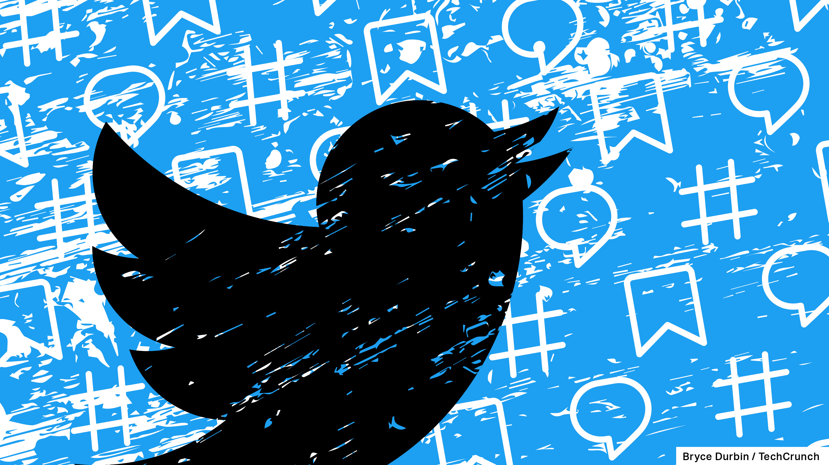
Conclusions
VADER, Afinn and Flair models produced the best results a model that is a tribrid of the three would likely improve classification accuracy
Being able to accurately classify tweets into sentiment buckets could impact the world at large
Security agencies can now be able to identify sentiments amongst tweets and weed out users whose negative tweets can lead to events like insurrections, election fraud, etc.
Brands can better gain an understanding of consumer sentiment
Can help schools proactively identify when students are engaging in/victims of cyberbullying
Can help nations see how its people are feeling about international relations
Notes:
Bethel

Slide 36

Questions?

Slide 37
References
https://www.kaggle.com/competitions/tweet-sentiment-extraction/overview
https://www.geeksforgeeks.org/python-sentiment-analysis-using-affin/
https://www.geeksforgeeks.org/twitter-sentiment-analysis-using-python/?ref=gcse
https://www.analyticsvidhya.com/blog/2021/10/sentiment-analysis-with-textblob-and-vader/
https://medium.com/analytics-vidhya/nlp-tutorial-for-text-classification-in-python-8f19cd17b49e

